Slide 1
Suresh M., Bowen S., Mathioudakis A., Gielo-Perczak K. Effects of a short-term, high inten- sity plyometric training regimen on postural control of young adults. Issue Rehabil. Orthop. Neurophysiol. Sport Promot. 2018; 25: 7–20. DOI: 10.19271/IRONS-000079–2018–25
EFFECTS OF A SHORT-TERM, HIGH INTEN- SITY PLYOMETRIC TRAINING REGIMEN ON POSTURAL CONTROL OF YOUNG ADULTS
Malavika Suresh
Shaniel Bowen Alexandros Mathioudakis Krystyna Gielo-Perczak
GP Musculoskeletal System Modeling Lab, Department of Biomedical Engineering, University of Connecticut, Storrs, CT, USA
EFEKTY KRÓTKIEGO I INTENSYWNEGO TRE- NINGU NA KONTROLĘ POSTAWY U MŁO- DYCH LUDZI
Malavika Suresh
Shaniel Bowen Alexandros Mathioudakis Krystyna Gielo-Perczak
GP Musculoskeletal System Modeling Lab, Department of Biomedical Engineering, University of Connecticut, Storrs, CT, USA
SUMMARy
Introduction
Plyometric exercises (such as jumping and hopping) are used by individuals involved in dynamic sports (athletes) to either en- hance athletic performance or for reha- bilitation. Short-term plyometric training has been shown to positively impact pos- tural control and muscle power in athletes. There have been no studies which investi- gated this training in non-athletic individu- als or considered postural stability changes as a result of this training. Positive changes in lower limb muscle power and therefore postural control, can be immensely benefi- cial to individuals recovering from injuries or individuals with impaired standing bal- ance due to neurological disorders.
STRESZCZENIE
Wstęp
Intensywne ćwiczenia ruchowe (takie jak skakanie w miejscu) są bardzo często stoso- wane przez sportowców w celu poprawy kon- dycji fizycznej lub rehabilitacji. Wykazano, że krótkoterminowe treningi ruchowe (ska- kanie w miejscu) pozytywnie wpływają na kontrolę postawy i siłę mięśni u sportowców. Nie przeprowadzono jednak takich badań u osób nie będących sportowcami, ani też nie uwzględniono zmian stabilności postawy w wyniku tych ćwiczeń. Pozytywne zmiany w sile mięśniowej kończyn dolnych, a zatem i kontroli postawy, mogą być niezwykle ko- rzystne dla osób rehabilitowanych z powodu urazów lub osób z zaburzoną równowagą z powodu zaburzeń neurologicznych.
Aim
This study investigated a short-term (10 week), high intensity, bi-lateral plyomet- ric training regime on ten healthy young adults to observe, analyze and character- ize their motor control and postural sta- bility. Measurements were taken twice per session: (i) pre-exercise and (ii) post-exer- cise. The participants’ center of pressure (CoP) recordings were carried out using a force plate, and their muscle activity was recorded using six electromyography (EMG) sensors placed on the right and left muscle bellies of the vastus lateralis (VL),
Cel
W przedstawionej pracy zbadano krótkoo- kresowy (10-tygodniowy), o wysokiej inten- sywności, równo obciążający obie kończyny, system treningowy (2 razy w tygodniu inten- sywne skakanie w miejscu przez 30 sekund, z przerwa 1–2 minuty, z 4-krotnym powtórze- niem ćwiczeń w ciągu jednej sesji) u dziesię- ciu zdrowych i młodych dorosłych (w wieku 20,1 ± 1,4 lat) zaproszonych do badań. Prze- prowadzono analizę stabilności postawy i kontrolę motoryczną uczestników ekspe- rymentu. Pomiary wykonywano dwa razy w ciągu jednej sesji: (i) przed ćwiczeniami
www.ironsjournal.org 7

Slide 2
EFFECTS OF A SHORT-TERM, HIGH INTENSITy PLyOMETRIC TRAINING REGIMEN ON POSTURAL CONTROL OF yOUNG ADULTS
biceps femoris (BF) and lateral gastroc-
nemius (GL).
i (ii) po ćwiczeniach. Zmienne położenia chwilowego środka reakcji (CoP) uczestni- ków wykonano za pomocą AMTI AccuSway (Watertown, MA) platformy rejestrującej 3 składniki reakcji siłowej (w trzech kierun- kach X, y, Z) i 3 składniki reakcji momentu (w trzech kierunkach X,y, Z), w funkcji cza- su. Aktywność mięśniową kończyn dolnych zarejestrowano za pomocą sześciu bezprze- wodowych czujników elektromiograficznych (EMG, Trigno Delsys, Natick, MA) umiesz- czonych na mięśniach prawej i lewej koń- czyny: vastus lateralis (VL), biceps femoris (BF) i lateral gastrocnemius (GL).
Results and conclusions
The results of this study indicate that plyomet- ric training consisting of high impact bi-later- al exercises induced major improvements in lower extremity power and postural stability. There were significant changes in most CoP measures and EMG-EMG coherence. There- fore, we can conclude that short-term, high intensity plyometric training should be ap- plied to impaired standing balance, and pos- sibly included in rehabilitation programs to improve their mobility and quality of life.
Wyniki i wnioski Wyniki przeprowadzonych badań wskazują, że proponowany trening, intensywne skaka- nie w miejscu indywidualnie dostosowane do możliwości fizycznych uczestnika, wy- wołał istotną poprawę stabilności postawy i sił generowanych w kończynach dolnych. Zarejestrowano znaczące zmiany położenia chwilowego środka reakcji (CoP) i spójności EMG-EMG. trening o wysokiej intensywności dostosowany indywidualnie do możliwości ruchowych pacjenta powinien być stosowa- ny do poprawy zaburzeń równowagi ciała i może być włączony do programów rehabi- litacyjnych w celu poprawy mobilności i ja- kości życia pacjentów.
Key words: plyometric training, posture, rehabilitation, balance, stability
Słowa kluczowe: krótkometryczny trening,
postawa, rehabilitacja, balans, stabilność
Data received: 10th October 2018 Date accepted: 12th December 2018
Data otrzymania: 10 październik 2018
Data zaakceptowania: 12 grudnia 2018
Introduction
This project investigates a short-term, high intensity, bilateral plyometric training regi- men on healthy, young adults to observe and analyze changes in their performance, mo- tor control and postural stability over time. The results of this study can be used and ap- plied to individuals with impaired standing balance due to neurological disorders to im- prove their quality of life.
Human upright (vertical) posture, from a mechanical perspective, is regarded as an unstable system which requires various control mechanisms to maintain the center of gravity (CoG) and the center of pressure (CoP) inside the base of support (Suzuki et al. 2012). The maintenance of CoG and CoP to- gether, is postural control. To stand with- out any support is a fundamental skill for
8 Issues of Rehabilitation, Orthopaedics, Neurophysiology and Sport Promotion – IRONS

Slide 3
EFFECTS OF A SHORT-TERM, HIGH INTENSITy PLyOMETRIC TRAINING REGIMEN ON POSTURAL CONTROL OF yOUNG ADULTS
independent mobility (Suzuki et al. 2012) (García-Massó et al. 2016). It was postulated by Bernstein (1967), that the central ner- vous system (CNS) also plays a vital role in simplifying these redundant degrees of free- dom by activating multiple muscle syner- gies (Shumway-Cook and Woollacott, 2012) (García-Massó et al. 2016). Human postural control, although seems simple, is a complex skill which relies on the integration of sen- sory information from the somatosensory, vi- sual and vestibular systems (Goh et al. 2017). These individual systems work in tandem to maintain postural control, and a number of studies have been conducted to confirm the involvement of cortical activity in postural control (Peterka, 2003) (Shumway-Cook and Woollacott, 2012) (Goh et al. 2017). It has been suggested that changes in cognitive function and attention can alter postural stability, and especially affects in- dividuals with movement disorders. These disorders are caused by damage to the mo- tor areas of the brain (Jacobs et al. 2015). Cerebral Palsy (CP) is a broad term that is used to describe a group of permanent dis- orders that impair control of movement, posture and motor function due to damage (non-progressive lesion) in the developing brain (Ajami and Maghsoudlorad, 2016) (Ballester-Plané et al. 2016). CP is a prevail- ing cause of physical disability in children. The incidence of CP according to the United Cerebral Palsy Association (Ucp.org, 2016) is approximately 10.000 infants per year in the USA. Studies have been conducted to observe individuals with CP over time as they progress from childhood into adult- hood. As time progresses, individuals find it harder to maintain balance due to factors such as increased pain and loss of mobility (Murphy et al. 2008). It was also observed that most of these individuals developed musculoskeletal problems early on, which goes to suggest that abnormal biomechan- ical forces and immobility led to the exces- sive physical stress and strain, which ulti- mately resulted in early joint degeneration
(Slaboda et al. 2013). This strongly suggests that the prevention or rather, mitigation of these complications could have a significant impact on maintaining function and mobility throughout the lifespan of this population – and therefore the survival of this population. Multiple studies investigating paradoxi- cal muscle movement during postural con- trol (Masani et al. 2003) (Peterka, 2003) (Suzuki et al. 2004) (Loram et al. 2007) (Asai et al. 2009) (Gawthrop et al. 2011) (Günther et al. 2011) (Shumway-Cook and Woollacott, 2012) (García-Massó et al. 2016) (Goh et al. 2017) observe that body insta- bility cannot be characterized and stabi- lized by intrinsic ankle stiffness alone and thus requires a modulation of muscle activ- ity to maintain balance. It supports the idea (Shumway-Cook and Woollacott, 2012) that contractile displacement is mechanically decoupled from bodily sway, implying that the stretch reflex mechanisms mediated in the lower limbs are required to successfully modulate muscle activity to maintain bal- ance (Suzuki et al. 2012). A way to quantify neuromuscular control is through measures of CoP and postural sway (Gimmon et al. 2011). An increase in postural sway might indicate impairment of postural control – which results in functional postural insta- bility (Gimmon et al. 2011) (Shumway-Cook
and Woollacott, 2012).
Plyometric exercise or training is popular amongst individuals involved in dynamic sports, and is usually used to improve athletic performance (Myer, 2005) (Chmielewski et al. 2006) (Váczi et al. 2013) (Kim and Park, 2016). It involves exercises such as jumping, hopping and skipping (Váczi, 2013). The identifying feature of plyometric training is the lengthening of the muscle-tendon unit, which is followed directly by shortening (stretch-shortening cycle) (Winter et al. 1996). These exercises are described as biphasic – which means they consist of ec- centric and concentric muscle action phases (Winter et al. 1996). Besides being able to improve athletic function, more recently,
www.ironsjournal.org 9

Slide 4
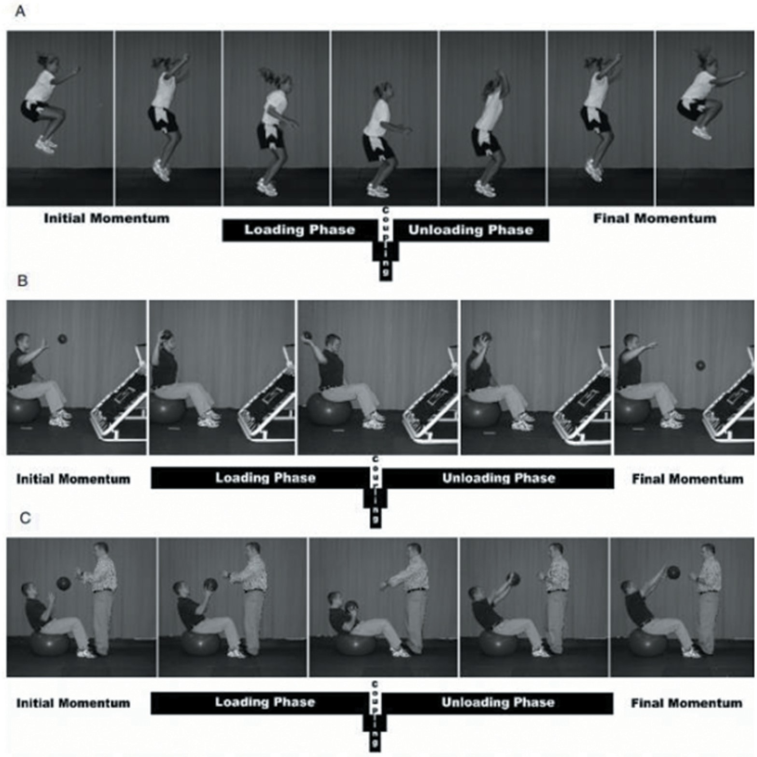
EFFECTS OF A SHORT-TERM, HIGH INTENSITy PLyOMETRIC TRAINING REGIMEN ON POSTURAL CONTROL OF yOUNG ADULTS
these exercises are being used in the reha- bilitation of injured athletes to help them return to their sport as safe and as fast as possible (Winter et al. 1996).
Aim The first specific aim is to relate the observed changes in the biomechanical measures (dynamic loading parameters) to postural
Figure 1: Phases of Plyometric Training Activity. Reprinted from ‘Plyometric Exercise in the Rehabilitation of Athletes: Physiological Responses and Clinical Application’, Journal of Orthopaedic & Sports Physical Therapy, vol. 36, no. 5, pp. 308–319, 2006, by T. Chmielewski et al., ‘Journal of Orthopaedic & Sports Physical Therapy, vol. 36, no. 5, pp. 308–319, 2006. (A) Lower Extremity Plyometric Exercise (B) Upper Extremity Plyometric Exercise (C) Trunk Plyometric Exercise.
Till date, there have been no published stud- ies investigating short-term, high intensity plyometric training regimens on healthy young adults. The few high-intensity studies (Winter et al. 1996) (Váczi, 2013) involved professional athletes.
stability. A reduction in the CoP parameters of velocity (ms⁻¹), 95% Ellipse Area (m²) and Medio-lateral (ML) and anterior-posterior (AP) sway (m) are hypothesized. A reduc- tion in these measures indicates improved balance, as the dynamic loading parameters that are applied to maintain postural control are decreased.
10 Issues of Rehabilitation, Orthopaedics, Neurophysiology and Sport Promotion – IRONS

Slide 5
EFFECTS OF A SHORT-TERM, HIGH INTENSITy PLyOMETRIC TRAINING REGIMEN ON POSTURAL CONTROL OF yOUNG ADULTS
The second specific aim is to determine the effect of this training in the lower limb muscle activity for the postural control task over time by evaluating the gross innervation input of synergistic (each) muscle pairs. The mean Electromyography (EMG) root-mean- square (RMS) comparison between muscle groups assesses the gross innervation input of select muscles during both testing condi- tions (before and after the training). As the study progresses, the mean EMG RMS sig- nal for synergistic muscle pairs (right and left muscle bellies of the vastus lateralis (VL), biceps femoris (BF) and lateral gastrocne- mius (GL) is expected to decrease. These muscles were chosen as they are known to have the largest impact on postural con- trol, and do not require additional filtering against cardiac artifacts (Jacobs et al. 2015). A reduction in this measure indicates that less power is exerted by each muscle pair to maintain postural stance, which emphasiz- es improved balance.
The last specific aim is to perform coher- ence analysis to characterize lower limb muscle patterns as the study progresses. EMG-EMG coherence estimations are used to analyze the coordination between syn- ergistic pairs of muscles by analyzing EMG signals in the frequency domain and analyz- ing their commonalities. An overall increase in coherence of muscle pairs over time is expected as the task becomes practiced and involuntary.
to their specifications, an Arduino Uno (Ar- duino.cc, 2017) microcontroller was used to trigger the three systems to record data simultaneously. The software used to ana- lyze the data after extraction from the pro- gram was MATLAB R2015a (Mathworks Inc., Natick, MA).
Ten healthy, young participants (Age: 20.1
± 1.4 years) were divided into three groups based on their gender, body mass and height. Each participant underwent 30 experimen- tal visits (30 times a week for 10 weeks) in total, where each session lasted approxi- mately half an hour. Participants were re- quired to take one day of rest, but no more than four days of rest between experimen- tal visits. The protocol described below ex- plains the entire procedure for each session. The experiment (recordings) itself consist- ed of two test sessions (pre and post-exer- cise) and a plyometric training interven- tion. This regimen was designed based on past literature:
Quiet standing on the force platform for 90 seconds while ground reaction forces and EMG measures are recorded.
There are six EMG sensors, which were placed on the left and right muscle bel- lies of the participants’ vastus lateralis (VL), biceps femoris (BF) and lateral gastrocnemius (GL) by the researcher.
Warming up the body for 5-minutes be- fore undergoing the plyometric training regimen.
All the sensors are removed from the participant, and not included again until step #8.
Warm-up includes dynamic ankle, knee, and hip stretches; stationary stepping; and shallow, stationary hops.
Stationary hopping (i.e. on the ground, in place) at a self-selected rate for 2-minutes.
Rest for 2 to 3 minutes.
Stationary hopping for 30 seconds at the fastest voluntary speed and height possi- ble for the participant (greatest or maxi- mum effort), for four sets with one-minute of rest in between sets.
Materials and methods
This study focuses solely on the biomechan- ical aspects of postural stability and balance control. The dynamic loading measures were recorded using one AMTI AccuSway Force Platform (AMTI AccuSway, Water- town, MA), and the muscle activity measures were recorded using six wireless EMG sen- sors (Trigno, Delsys Inc. Natick, MA). EEG measures were taken using the Brain Vision actiCHamp system (Brain Products, GmbH, Munich, Germany). To be able to interface to three different sensor systems and cater
www.ironsjournal.org 11

Slide 6
EFFECTS OF A SHORT-TERM, HIGH INTENSITy PLyOMETRIC TRAINING REGIMEN ON POSTURAL CONTROL OF yOUNG ADULTS
Rest for 2 to 3 minutes.
Cool down the body for 3–5 minutes con- sisting of 3 sets of 10 seconds submaximal hopping, followed by slow walking or sta- tionary stepping.
Quiet standing on the force platform for 90 seconds while EMG (and EEG) mea- sures are taken.
(García-Massó et al. 2016). The first 10 sec- onds and the last 10 seconds were discard- ed before computation of any variables. In the time domain, the balance variables/dy- namic loading parameters which were com- puted were: CoP velocity (ms-1), CoP 95% Ellipse Area (m2) and displacement (m) in the medio-lateral (ML) and anterior-pos- terior (AP) directions. These parameters were calculated for every training session (pre and post-exercise). The CoP signals were also normalized to each participant’s weight and height.
The CoP velocity decreased across all groups of participants as hypothesized. Over- all, Group 2 participants showed the most significant reduction. The percentage differ- ence in the velocity was calculated and tabu- lated for each participant in Figure 2. Please note that for the proceeding graphs, partic- ipants 1 and 2 are part of group 1, partici- pants 3–6 are in group 2, and participants 7–10 are in group 3.
The CoP 95% Ellipse Area also decreased across all groups of participants over time, and can be seen in Figure 3. Once again, overall, Group 2 showed the most signif- icant reductions in the average CoP 95% Ellipse Area.
Postural sway in the medio-lateral (ML) and anterior-posterior (AP) directions were expected to reduce overall, as well. How- ever, it reduced for certain individuals and increased for others. While there were no significant reductions in postural sway, over- all the displacement across all participants stabilized after week 5.
EMG signals were sampled at 1926 Hz and pre-processed to delete background noise and interference. First, a notch filter was ap- plied to remove the 60 Hz power line compo- nent and its secondary harmonics. This was followed by a second-order low pass filter of 100 Hz. The presence of electrocardiogram signals in EMG could increase the coherence between core muscles (García-Massó et al. 2016). Independent component analysis was not needed to be taken into consideration as
During the plyometric training sessions (i.e. NOT when recordings were taken), work-out music was played to keep the participants motivated always. Continuous verbal encouragement and feedback were also given by the researcher(s). It is also to be noted that for step #5, a two-minute rest was given between each set for the first 4 weeks. It was then stepped up to 1.5 minutes in week 5 and finally, one minute in week 6. This gradual progression (Chmielewski, 2006) of recovery time was carried out to ensure that the participants had enough rest for proper execution of the exercise. As the training became more practiced and volun- tary, the recovery time was reduced based on observation and mutual consent.
The vertical jump performance test was executed bi-weekly throughout the study. Participants were standing next to a wall, while remaining flat-footed to record stand- ing height. The vertical jump test was per- formed using the tape method (similar to the chalk method) (Váczi, 2013), where each participant was given a piece of colored tape placed on their dominant hand. They then had to jump bilaterally (using proper form as instructed) and slap the tape as high as they possibly can on the wall. Each partic- ipant had three trials, with a few minutes of rest in between each trial. The maximum vertical jump height from each session was recorded for further analysis.
Results
The CoP signals were sampled at 100 Hz and low-pass filtered using a second order But- terworth IIR filter with a cut off frequency of 15 Hz (as suggested in previous literature
12 Issues of Rehabilitation, Orthopaedics, Neurophysiology and Sport Promotion – IRONS

Slide 7
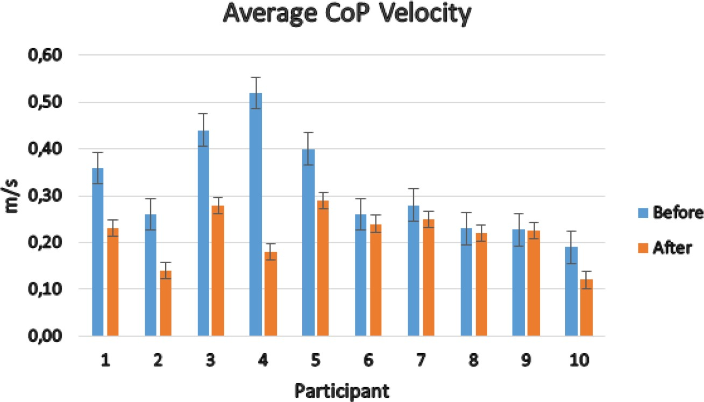
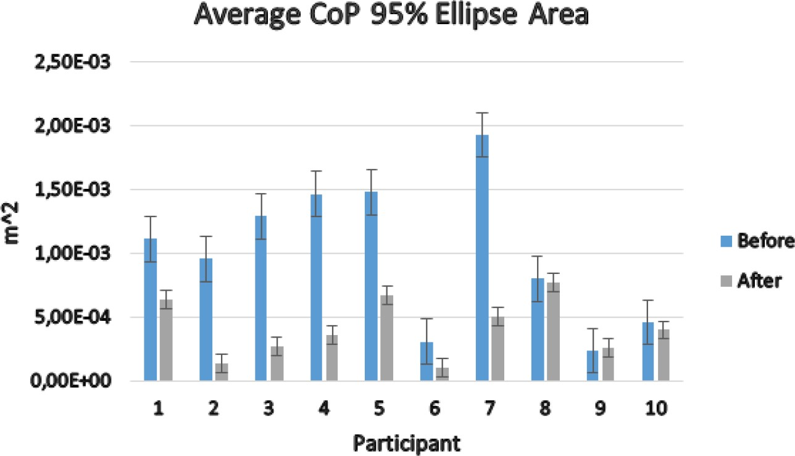
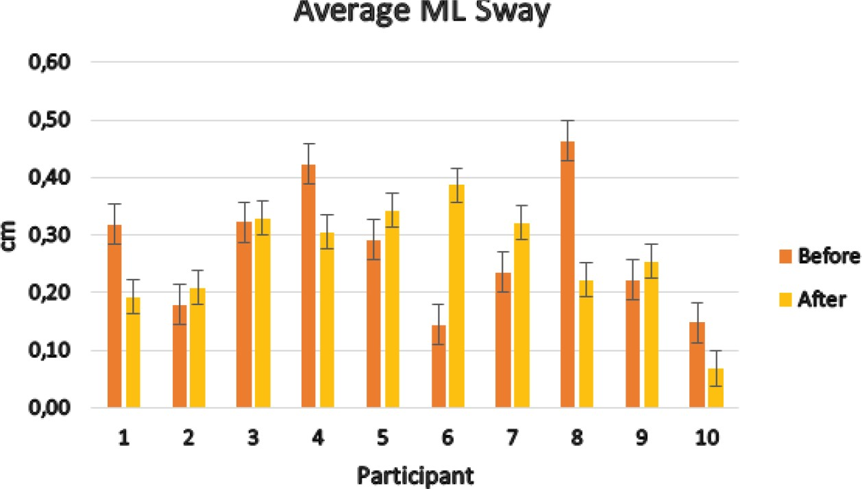
EFFECTS OF A SHORT-TERM, HIGH INTENSITy PLyOMETRIC TRAINING REGIMEN ON POSTURAL CONTROL OF yOUNG ADULTS
Figure 2: Average center of pressure velocity across all participants.
Figure 3: Average center of pressure 95% ellipse area across all participants.
Figure 4: Average ML sway across all participants.
www.ironsjournal.org
13

Slide 8
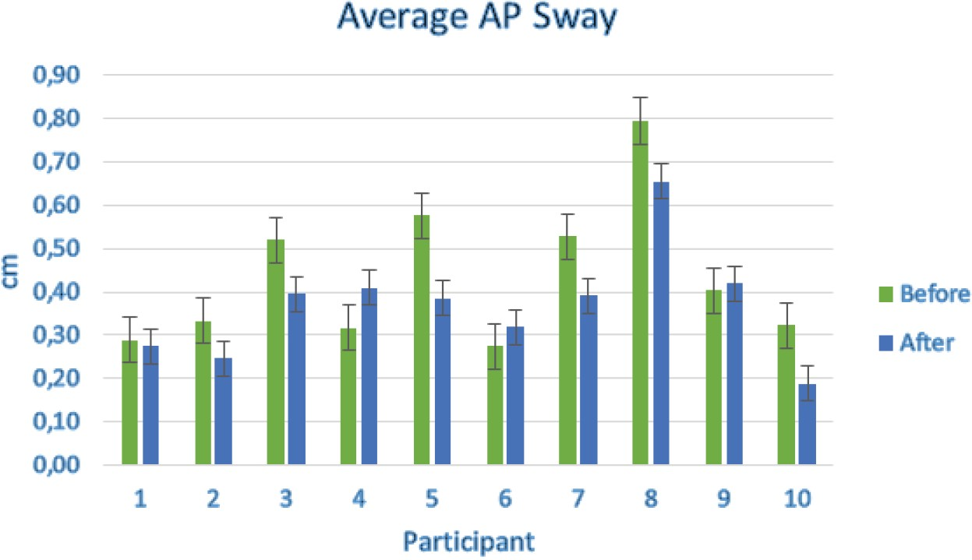
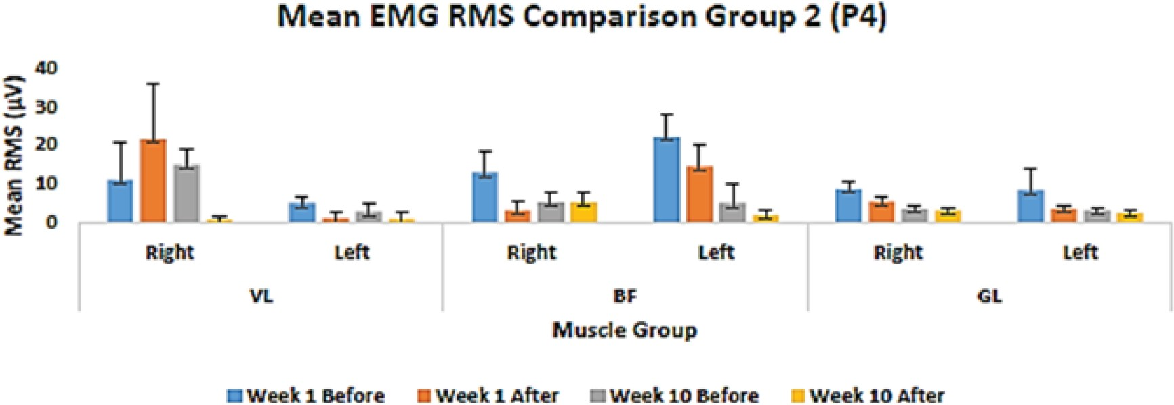
EFFECTS OF A SHORT-TERM, HIGH INTENSITy PLyOMETRIC TRAINING REGIMEN ON POSTURAL CONTROL OF yOUNG ADULTS
Figure 5: Average AP sway across all participants.
the muscle bellies chosen (VL, BF, GL) are known to not need any additional filtering against electrocardiogram interference (Ja- cobs et al. 2015) (García-Massó et al. 2016). The first 10 seconds and the last 10 seconds were discarded in order to use the same time period as the CoP signals.
The mean value of the root-mean-square (RMS) EMG signal was then computed as a variable of the magnitude for muscle acti- vation for each trial. The EMG RMS calcula- tion is considered to provide the most insight on the amplitude of the EMG signal as it gives a measure of the power of the signal. The EMG RMS was hypothesized to de- crease as the study progressed. This is most- ly seen across all groups (and individual) of participants. Figure 6 below shows a random participant’s data from each of the three
groups of participants.
Coherence analysis was carried out in accordance with past literature (Grosse et al. 2004) (Jacobs, 2015) (García-Massó et al. 2016). In the frequency domain, the EMG signals were analyzed by estimating the EMG-EMG coherence of synergistic muscle pairs (single-pair estimations). Pairs of mus- cles are defined as the comparison between
(1) left and right VL; (2) left and right BF;
(3) and left and right GL. The single pair coherence estimations were performed us- ing the Welch method (García-Massó et al. 2016) (an extension of the Pearson’s cor- relation coefficient):
2
2 �𝑓𝑓𝑓𝑓_{𝑥𝑥𝑥𝑥𝑥𝑥𝑥𝑥}𝜆𝜆𝜆𝜆�
�𝑓𝑓𝑓𝑓 𝜆𝜆𝜆𝜆�𝑅𝑅𝑅𝑅 (𝜆𝜆𝜆𝜆)� = �
2
𝑥𝑥𝑥𝑥𝑥𝑥𝑥𝑥 𝑥𝑥𝑥𝑥𝑥𝑥𝑥𝑥
�𝑓𝑓𝑓𝑓_{𝑥𝑥𝑥𝑥𝑥𝑥𝑥𝑥}(𝜆𝜆𝜆𝜆)𝑓𝑓𝑓𝑓_{𝑥𝑥𝑥𝑥𝑥𝑥𝑥𝑥}(𝜆𝜆𝜆𝜆)�
[Eq.1]
�𝑅𝑅𝑅𝑅_{𝑥𝑥𝑥𝑥𝑥𝑥𝑥𝑥}(𝜆𝜆𝜆𝜆)� =
�𝑓𝑓𝑓𝑓 (𝜆𝜆𝜆𝜆)𝑓𝑓𝑓𝑓 (𝜆𝜆𝜆𝜆)�
𝑥𝑥𝑥𝑥𝑥𝑥𝑥𝑥 𝑥𝑥𝑥𝑥𝑥𝑥𝑥𝑥
Figure 6: EMG RMS for a random participant.
14 Issues of Rehabilitation, Orthopaedics, Neurophysiology and Sport Promotion – IRONS

Slide 9
EFFECTS OF A SHORT-TERM, HIGH INTENSITy PLyOMETRIC TRAINING REGIMEN ON POSTURAL CONTROL OF yOUNG ADULTS
Where R_{xy}(λ) is the intermuscular coherence, f_{xy}(λ) is the cross-spectrum between both signals, f_{xx}(λ) is the auto-spectrum of the first signal and f_{yy}(λ) is the auto-spectrum of the second signal.
The estimated coherence using Welch’s periodogram (García-Massó et al. 2016) method was obtained with the assistance of in-built MATLAB functions. The coher- ence spectra are determined using the fast Fourier transform (FFT). The spectra de- rived using the FFT approach are defined pointwise, and the difference in frequen- cy between two adjacent points is given by the sampling rate divided by the FFT win- dow size (Grosse, 2004). A non-overlapping Hamming window of 512 points (number of samples/2 = 417 which closest power of 2 is 512) and a frequency range from 0–55 Hz was analyzed.
In accordance with previous literature (García-Massó et al. 2016), the statistical significance for single pair coherence esti- mations was computed to obtain a threshold which was 95% confidence interval per mus- cle pair. The equation used to calculate this 95% confidence threshold is:
Discussion
In this study, it was hypothesized that a short- term (10 week), high intensity, bilateral plyometric regimen will change and improve various dynamic measures in young adults. This was the first study to investigate a high intensity plyometric training regimen in non-athletic young adults (i.e. not profes- sional athletes).
When assessing postural stability mea- sures (dynamic loading parameters), the CoP velocity and CoP 95% Ellipse Area (EA) decreased across all participants, as expect- ed. The percentage range of decrease for the CoP variables ranged from a 0.5% decrease to a 66% decrease for certain individuals. This is an extremely large range of values that were obtained. This decrease could be attributed to varying time frames and inten- sities of muscle reorganization for each par- ticipant (Váczi, 2013) (García-Massó et al. 2016). It was observed that Group 3 (male) participants had the lowest change in CoP velocity. This participant group were on the higher end of the body mass and height scale. All participants were instructed and ver- bally motivated to ensure that maximal in- tensity was being exerted throughout the training regimen. Intensity and frequen- cy are inversely proportional often (Váczi, 2013), in training programs. These two fac- tors in this study remained constant through- out and were not changed. The frequency of the jumps was determined by each indi- vidual, depending on their comfort and ca- pabilities. During the training regimen, the participants were limited to the ceiling. It was evident that especially group 3 partic- ipants could, in fact, jump to a higher level with maximal effort. This could be an at- tributing factor to this large difference in variation between the different participant groups, as group 3 participants were actu- ally executing the exercise at a sub-maxi- mal level. They were instructed to however compensate this by increasing the frequency of their jumps. A similar trend was also ob- served for the CoP 95% Ellipse Area, where
𝑥𝑥𝑥𝑥̅ ± 𝑧𝑧𝑧𝑧 ^{𝑠𝑠𝑠𝑠𝑠𝑠𝑠𝑠} [Eq.2]
√𝑛𝑛𝑛𝑛
Where ‘𝑥 ’̅ is the mean of the sample, ‘sd’ is the standard deviation of the sample, ‘n’ is the number of samples, and ‘z’ is the t-value for the one-sided confidence limit at 95% (p < 0.05).
It was hypothesized that higher ampli- tudes of muscle activity is expected to be observed in the lower frequency range (0–10 Hz) and an overall increase in coher- ence over time. The results in Figure 7 show that the coherence did increase across all participants. Most of the increase in coher- ence was in the lower leg (GL) as opposed to the upper leg (VL, BF).
For the vertical jump test, performance (which was recorded bi-weekly) improved overall across all groups of participants. This can be seen in Figure 6 below.
www.ironsjournal.org 15

Slide 10
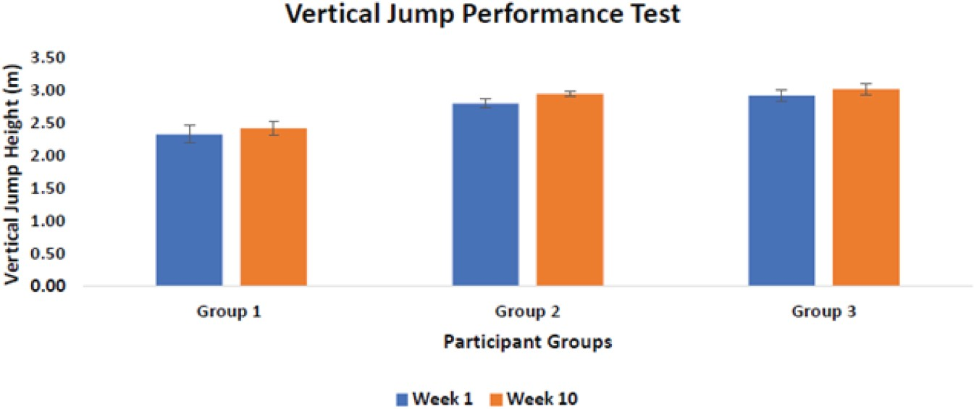
EFFECTS OF A SHORT-TERM, HIGH INTENSITy PLyOMETRIC TRAINING REGIMEN ON POSTURAL CONTROL OF yOUNG ADULTS
Figure 7: Average vertical jump height for groups 1–3 before and after the plyometric regimen.
group 3 participants improved, but signifi- cantly less than their counterparts.
During the study, the recovery time be- tween the four repetitions of the plyomet- ric training exercise was shortened as the study progressed. The participants were giv- en a two-minute recovery period in between the sets. This reduced to one and a half min- utes in week 4 and 5 and finally, to one min- ute rest from week 6 onward. As suggested by earlier studies (Chmielewski, 2006), this was done to ensure that the plyometric ac- tivity was first introduced to ensure neu- romuscular control and endurance before increasing the frequency and/or decreas- ing the recovery period. As seen consistently throughout the results, the CoP velocity and CoP 95% EA increased during this period of time, as expected. This could be attributed to compensation of the lower limbs to en- sure that sufficient muscle force is available for the optimal performance of these exer- cises (Chmielewski, 2006).
The volume, or total work performed (number of sets/repetitions) also remained constant throughout the study. The number of repetitions remained constant through- out the study, so it was evident that decreas- ing the recovery time in between repetitions did have an impact on the performance by increasing the CoP velocity and CoP 95% Ellipse Area.
In terms of postural sway, there were no significant differences observed. From pre- vious work (Myer, 2005) (Chmielewski et al. 2006) (Martyn-St James and Carroll, 2009)
(Shumway-Cook and Woollacott, 2012) (Váczi et al. 2013) (Zhao et al. 2014) (García- Massó et al. 2016) (Kim and Park, 2016), it is seen that it takes (on average) four weeks for a task to become practiced and involun- tary. This could be a plausible explanation as to why the postural sway stabilized mid- way through the study.
As expected, the EMG RMS values signifi- cantly decreased across all groups of partic- ipants, indicating that over time, they re- quired less power by each muscle to achieve the same postural stance. The decrease in muscle activation (muscle force production) indicates improved postural stability as less force is exerted by each muscle to maintain bipedal stance.
Inter-muscle coordination was evaluated by analyzing EMG-EMG coherence of syn- ergistic pairs of muscles over time. Consis- tent with previous studies (Grosse, 2002) (Grosse et al. 2004) (Jacobs et al. 2015) (García-Massó et al. 2016), it is observed that significant coherence was observed in the lower frequency range (0–10 Hz) for the postural control task. The coherence also changed and (mostly) increased across all participants. This is indicative of increased or better inter-muscular coordination as the study progressed, which emphasizes improved standing balance. Similar to the mean EMG RMS analysis, the larger differ- ence was seen in the GL muscle compared to the VL and BF muscles. This further vali- dates that the lower leg contributes more to postural stability compared to the upper leg.
16 Issues of Rehabilitation, Orthopaedics, Neurophysiology and Sport Promotion – IRONS

Slide 11
EFFECTS OF A SHORT-TERM, HIGH INTENSITy PLyOMETRIC TRAINING REGIMEN ON POSTURAL CONTROL OF yOUNG ADULTS
With regards to the vertical jump perfor- mance test, a percentage change of 4–5% in- dicates significant changes in lower leg pow- er have occurred, which further validates the benefits of maximal intensity plyometric training. Previous studies involving profes- sional athletes showed a 4% improvement (Váczi, 2013) in six weeks. Considering this population was non-athletes, this is regard- ed as a major improvement. As previously suggested (Váczi, 2013), this improved inter- muscular coordination, possible increased neural drive, and changes in the muscle-ten- don complex have occurred. These neuro- physiological changes together, suggest the improved ability to store and release elastic energy during the stretch-shortening cycle. Of course there were some limitations that should be taken into account, such as indi- vidual variations in body segment position changes or the population sample size. The population demographics in this study in- volved more male participants compared to female participants. It would have been more conclusive if there was a larger demograph- ic observed. Another limitation was that the participants were restricted to the ceiling in terms of how high they could jump, which especially affected the taller group of partic- ipants (group 3). One more limitation was that there was only one force platform used. Evaluating inter-limb coordination would be more effective if there were two force plat- forms used so that the CoP and ground re- action forces exerted from each limb would be more accurate, rather than analyzing the overall (average) CoP measures. Another limiting factor was the number of EMG sen- sors. This study was limited to six sensors, so the muscles had to be chosen strategically. Another very important muscle in postural control that was not measured is the tibialis anterior (TA), which would have been inter- esting to measure if there had been enough
sensors to accommodate.
It can be seen that this study’s plyometric training regimen has had a positive effect on the lower limb strength, muscle activation
and postural stabilities of the participants involved. Practically, it can be used as an al- ternative approach in improving and treat- ing impaired standing balance. This training could potentially be used to not only help individuals enhance athletic performance and recover from injury, but also to indi- viduals with neuromuscular disorders to improve their strength and mobility. A reg- ular, well-designed, high intensity plyomet- ric training regimen could potentially be in- corporated into rehabilitation programs as an alternative to improve impaired standing balance, and subsequently improve quality of life. A very under-represented and un- der-researched population is those suffer- ing from Cerebral Palsy (CP), and specifical- ly adults with CP. This plyometric training regimen could be extended to a longer pe- riod of time to be able to see beneficial and significant results in their performance, mo- tor control and postural stability. Addition- ally, this study could also be applied to the geriatric population, individuals with Par- kinson’s disorder (as they are believed to have a depth impairment (Shumway-Cook and Woollacott, 2012)), muscular dystro- phy, and/or people recovering from a stroke.
Conclusions
A short-term, high intensity, bilateral plyo- metric training regimen in young adults showed major improvements in lower limb strength.
The same bilateral plyometric training regimen showed improved intermuscular coherence in the participants.
The above conclusions support the asser- tion that postural stability was improved as well in the young adults that completed the study.
Acknowledgements
The authors would like to thank Gina Di- Giacomo for assistance with the final man- uscript editing and Anna Roto for initial guidance of data collection.
www.ironsjournal.org
17

Slide 12
EFFECTS OF A SHORT-TERM, HIGH INTENSITy PLyOMETRIC TRAINING REGIMEN ON POSTURAL CONTROL OF yOUNG ADULTS
REFERENCES
Ajami S., Maghsoudlorad AA. (2016) ‘The Role of Information Systems to Manage Cere- bral Palsy.’ Iran J Child Neurol. Spring 2016; 10(2): 1–9.
‘United Cerebral Palsy’, Ucp.org, 2016. [Online]. Available: http://ucp.org/. [Ac- cessed: 12-Aug-2016].
Asai Y., Tasaka Y., Nomura K., Nomura T., Casadio M., Morasso P. (2009) ‘Correction: A Model of Postural Control in Quiet Stand- ing: Robust Compensation of Delay-Induced Instability Using Intermittent Activation of Feedback Control’. PLoS ONE, vol. 4, no. 7. Chmielewski T., Myer G., Kauffman D., Tillman S. (2006) ‘Plyometric Exercise in the Rehabilitation of Athletes: Physiological Responses and Clinical Application’ Journal of Orthopaedic & Sports Physical Therapy, vol. 36, no. 5, pp. 308–319.
García-Massó X., Pellicer-Chenoll M., Gonzalez L., Toca-Herrera J. (2016)‘The difficulty of the postural control task affects multi-muscle control during quiet standing’. Experimental Brain Research, vol. 234, no. 7, pp. 1977–1986.
Gawthrop P., Loram I., Lakie M., Gollee H. (2011) ‘Intermittent control: a computational theory of human control’. Biological Cyber- netics, vol. 104, no. 1–2, pp. 31–51.
Gimmon Y., Riemer R., Oddsson L., Melzer
I. (2011) ‘The effect of plantar flexor muscle fatigue on postural control’. Journal of Elec- tromyography and Kinesiology, vol. 21, no. 6, pp. 922–928.
Goh K., Morris S., Lee W., Ring A., Tan
T. (2017) ‘Postural and cortical responses following visual occlusion in standing and sitting tasks’. Experimental Brain Research. Grosse P. (2002) ‘EEG–EMG, MEG–EMG and EMG–EMG frequency analysis: physio- logical principles and clinical applications’. Clinical Neurophysiology, vol. 113, no. 10, pp. 1523–1531, 2002. Grosse P., Edwards M., Tijssen M., Schrag A., Lees A., Bhatia K., Brown P. (2004) ‘Patterns of EMG-EMG coherence in limb
dystonia’. Movement Disorders, vol. 19, no. 7, pp. 758–769, 2004.
Günther M., Putsche P., Leistritz L., Grim- mer S., (2011) ‘Phase synchronisation of the three leg joints in quiet human stance’. Gait & Posture, vol. 33, no. 3, pp. 412–417.
Jacobs J., Wu G., Kelly K. (2015) ‘Evidence for beta corticomuscular coherence during hu- man standing balance: Effects of stance width, vision, and support surface’, Neuroscience, vol. 298, pp. 1–11.
Loram I., Maganaris C.,. Lakie M. (2007) ‘The passive, human calf muscles in relation to standing: the non-linear decrease from short range to long range stiffness’, The Journal of Physiology, vol. 584, no. 2, pp. 661–675. Kim Y., Park S. (2016)‘Comparison of whole- body vibration exercise and plyometric exer- cise to improve isokinetic muscular strength, jumping performance and balance of female volleyball players’. Journal of Physical Ther- apy Science, vol. 28, no. 11, pp. 3140–3144. Martyn-St James M., Carroll S. (2009) ‘Effects of different impact exercise modali- ties on bone mineral density in premenopaus- al women: a meta-analysis’. J Bone Miner Me- tab, vol. 28, no. 3, pp. 251–267.
Masani K. (2003) ‘Importance of Body Sway Velocity Information in Controlling Ankle Ex- tensor Activities During Quiet Stance’. Jour- nal of Neurophysiology, vol. 90, no. 6, pp. 3774–3782.
Murphy K., Molnar G., Lankasky K. (2008) ‘Medical and functional status of adults wth ce- rebral palsy’. Developmental Medicine & Child Neurology, vol. 37, no. 12, pp. 1075–1084. Myer G. (2015) ‘The Effects of Plyometric Versus Dynamic Stabilization and Balance Training on Lower Extremity Biomechanics’, American Journal of Sports Medicine, vol. 34, no. 3, pp. 445–455.
Peterka R., (2003)‘Dynamic Regulation of Sensorimotor Integration in Human Postural Control’. Journal of Neurophysiology, vol. 91, no. 1, pp. 410–423.
Issues of Rehabilitation, Orthopaedics, Neurophysiology and Sport Promotion – IRONS 18

Slide 13
EFFECTS OF A SHORT-TERM, HIGH INTENSITy PLyOMETRIC TRAINING REGIMEN ON POSTURAL CONTROL OF yOUNG ADULTS
Segarra, Pueyo R. (2016).‘Measuring intellec- tual ability in cerebral palsy: The comparison of three tests and their neuroimaging correlates’, Research in Developmental Disabilities, vol. 56, pp. 83–98.
Shumway-Cook A., Woollacott M. (2012) Motor control, 1st ed. Philadelphia [u.a.]: Wolters Kluwer Health, Lippincott Williams & Wilkins.
Slaboda J., Lauer R., Keshner E. (2013) ‘Postural Responses of Adults With Cerebral Palsy to Combined Base of Support and Visu- al Field Rotation’. IEEE Trans. Neural Syst. Rehabil. Eng., vol. 21, no. 2, pp. 218–224. Suzuki Y., Nomura T., Casadio M., Morasso
P. (2012) ‘Intermittent control with ankle, hip, and mixed strategies during quiet standing: Atheoretical proposal basedonadouble invert- ed pendulum model’, Journal of Theoretical Biology, vol. 310, pp. 55–79.
Winter DA., Patla AE., Prince F., Ishac M., Gielo-Perczak K. (1998). ‘Stiffness control of balance in quiet standing’. Journal of Neuro- physiology, 80, 1211–1221.
Váczi M., Tollár J., Meszler B., Juhász I., Karsai I. (2013) ‘Short-Term High Intensity Plyometric Training Program Improves Strength, Power and Agility in Male Soccer Players’. Jour- nal of Human Kinetics, vol. 36, no. 1.
Zhao R., Zhao M., Zhang L. (2014) ‘Efficiency of Jumping Exercise in Improving Bone Min- eral Density Among Premenopausal Women: A Meta-Analysis’. Sports Med, vol. 44, no. 10, pp. 1393–1402.
‘Arduino – ArduinoBoardUno’, Arduino. cc, 2017. [Online]. Available: https://www. arduino.cc/en/main/arduinoBoardUno. [Accessed: 15-Apr-2017].
www.ironsjournal.org
19

Slide 14
EFFECTS OF A SHORT-TERM, HIGH INTENSITy PLyOMETRIC TRAINING REGIMEN ON POSTURAL CONTROL OF yOUNG ADULTS
Authors reported no source of funding.
Authors declared no conflict of interest.
Autorzy nie zgłosili źródła finansowania. Autorzy nie deklarowali konfliktu interesów.
Author responsible for correspondence: Krystyna Gielo-Perczak
University of Connecticut
Department of Biomedical Engineering GP Musculoskeletal System Modeling Lab
260 Glenbrook Rd., Unit 3247 Storrs, CT 06269-2247
USA
krystyna.gielo-perczak@uconn.edu
Autor odpowiedzialny za korespondencję:
Krystyna Gielo-Perczak University of Connecticut
Department of Biomedical Engineering GP Musculoskeletal System Modeling Lab
260 Glenbrook Rd., Unit 3247 Storrs, CT 06269-2247
USA
krystyna.gielo-perczak@uconn.edu

